Slide 1

Done by : Manel Ait Amer

Slide 2
Instructions for ESCAPE ROOM:
-In this game the gamer should find the way how to go out and reach
the target room (The Outside).
-Gamer should find all the keys to open the doors and get outside.
-Gamer can also find some items to help him to get outside.
-

Slide 3
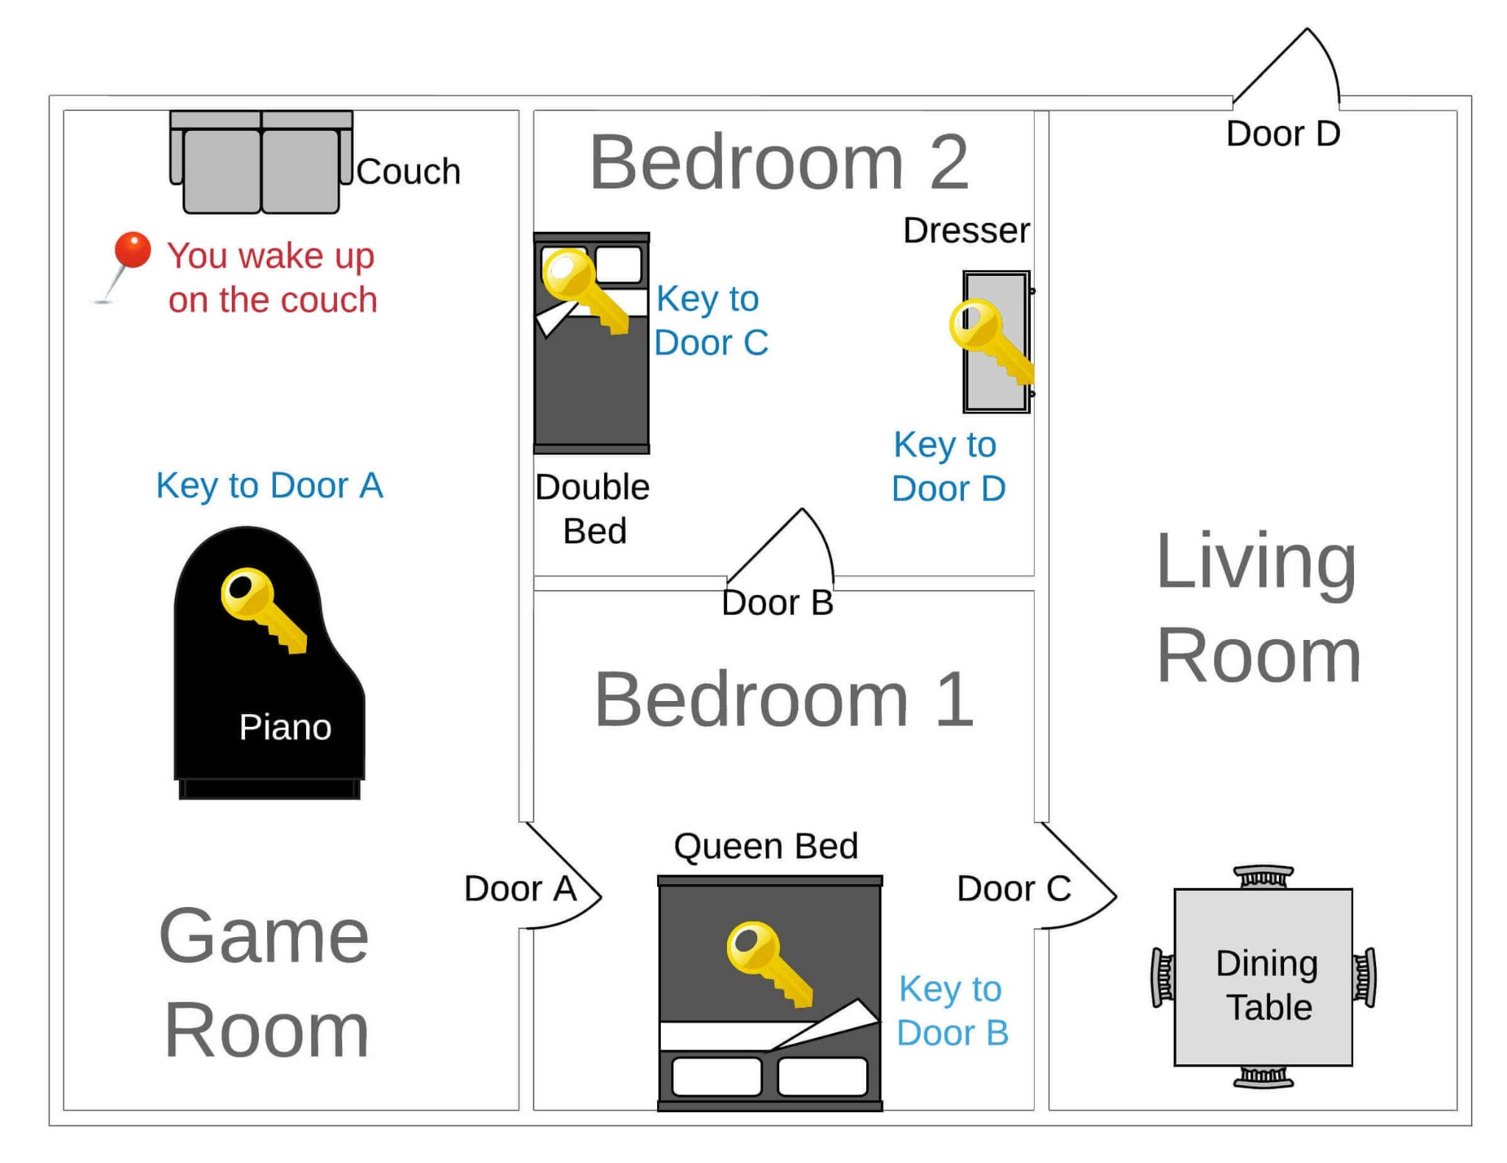
MAP:
Vestibulum congue
We added to the game also some items:
-Flashlight on Piano
_blueprints

Slide 4
THANK YOU

